Slide 1
Best practices on Sustainable Land Management for Achieving Degradation Neutrality Resilient Food Systems and Knowledge Exchange Learning Workshop
September 20 – 23
Blantyre, Malawi
Lynn Kota

Slide 2
Achieving Sustainable Land Management and Land Degradation Neutrality
Land is the most important single productive asset available to the majority of EmaSwati for use to support their livelihoods.
It is the country’s greatest asset that needs to be conserved for the development of Eswatini, whose economy is agricultural based. Being a limited resource attracts competition between different land uses with dire consequences at times.
By subscribing to the LDN Concept, Eswatini boldly commits to be a land degradation neutral country by 2030.

Slide 3
LDN Targets for Eswatini
Increase forest cover through Afforestation/Agroforestry in existing forests; areas of shrubs/grassland; wetlands; croplands by 465,290 Ha
Increase by 10% net land productivity in all land cover categories
through SLM practices Improve by 50% productivity and SOC stocks in cropland and grasslands by 2030
Rehabilitate 115,000 Ha of degraded and abandoned land for crop production by 2030
Various operational frameworks therefore, have objectives and strategies that are relevant to Sustainable Land Management (SLM) or LDN.

Slide 4
Willingness of communities to learn and work to achieve Sustainable Land Management as well as willingness to adopt and use relevant VGGT

Slide 6
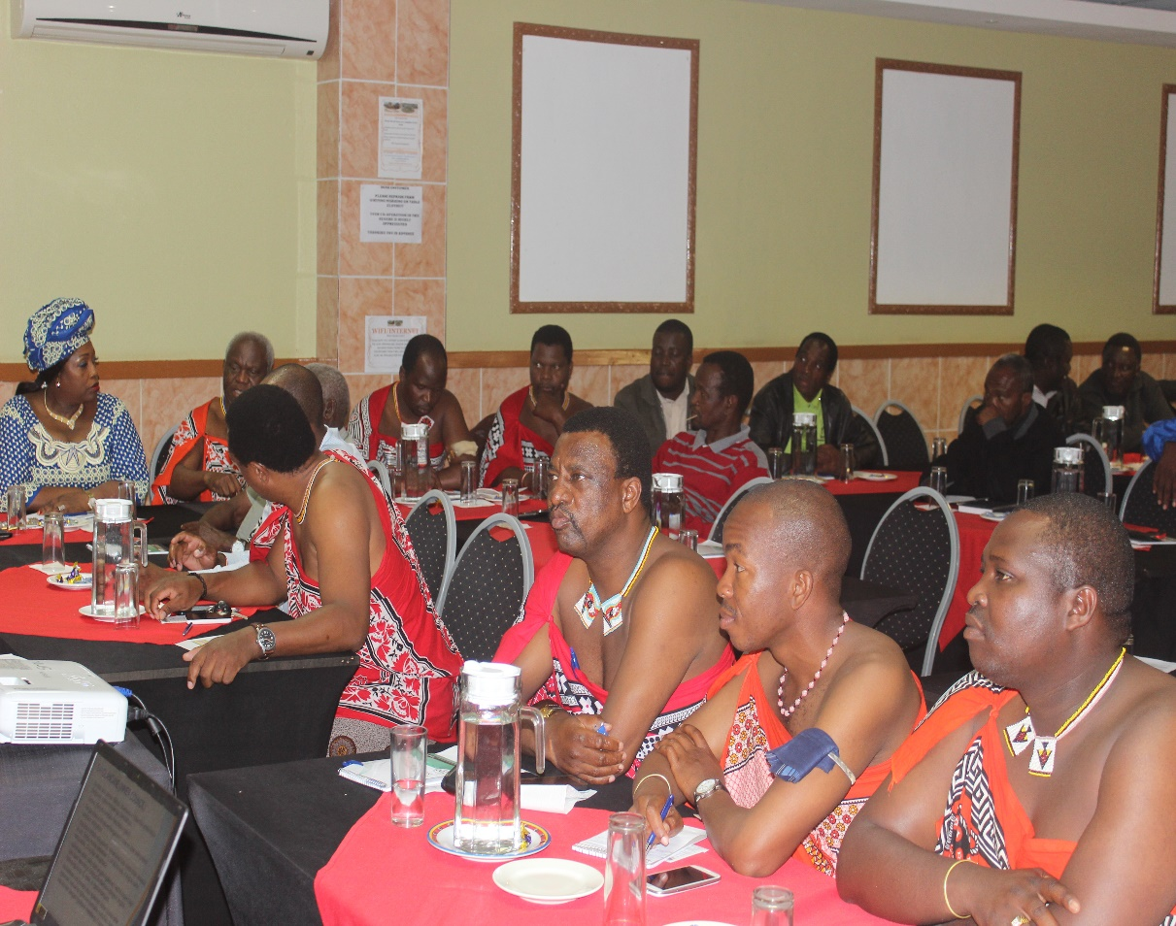
Political Will by both Traditional Authorities and the Government of Eswatini to Achieve Sustainable Land Management

Slide 7
Project Achievements
Use of Machinery in severely degraded lands

Slide 8
Ndinda gulley - before and after

Slide 9
Use of both machinery and community human resources

Slide 10
Re-use of previously degraded lands

Slide 11
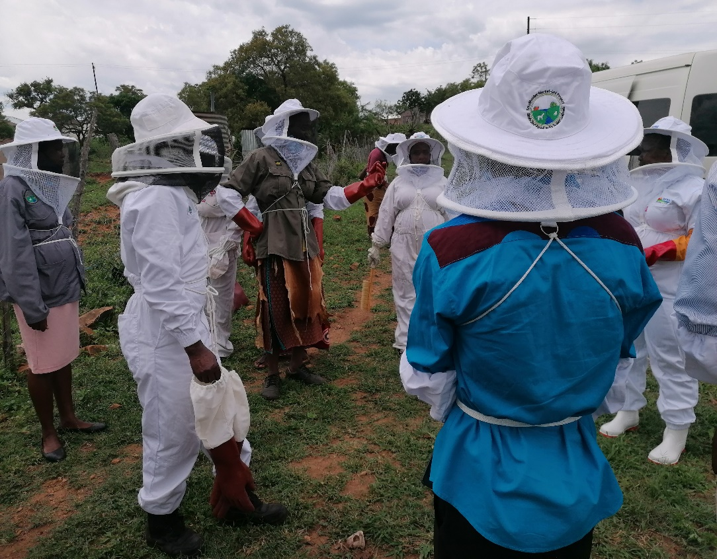
Honey Production for Forest Resources Conservation and Increase in Household Income

Slide 12
Wetland Conservation
The Ngololweni wetland before conservation
During the recovery process

Slide 13
Wetland Resources for both economic use value and Global Environment Benefits
Recovered
Some of the benefits

Slide 14
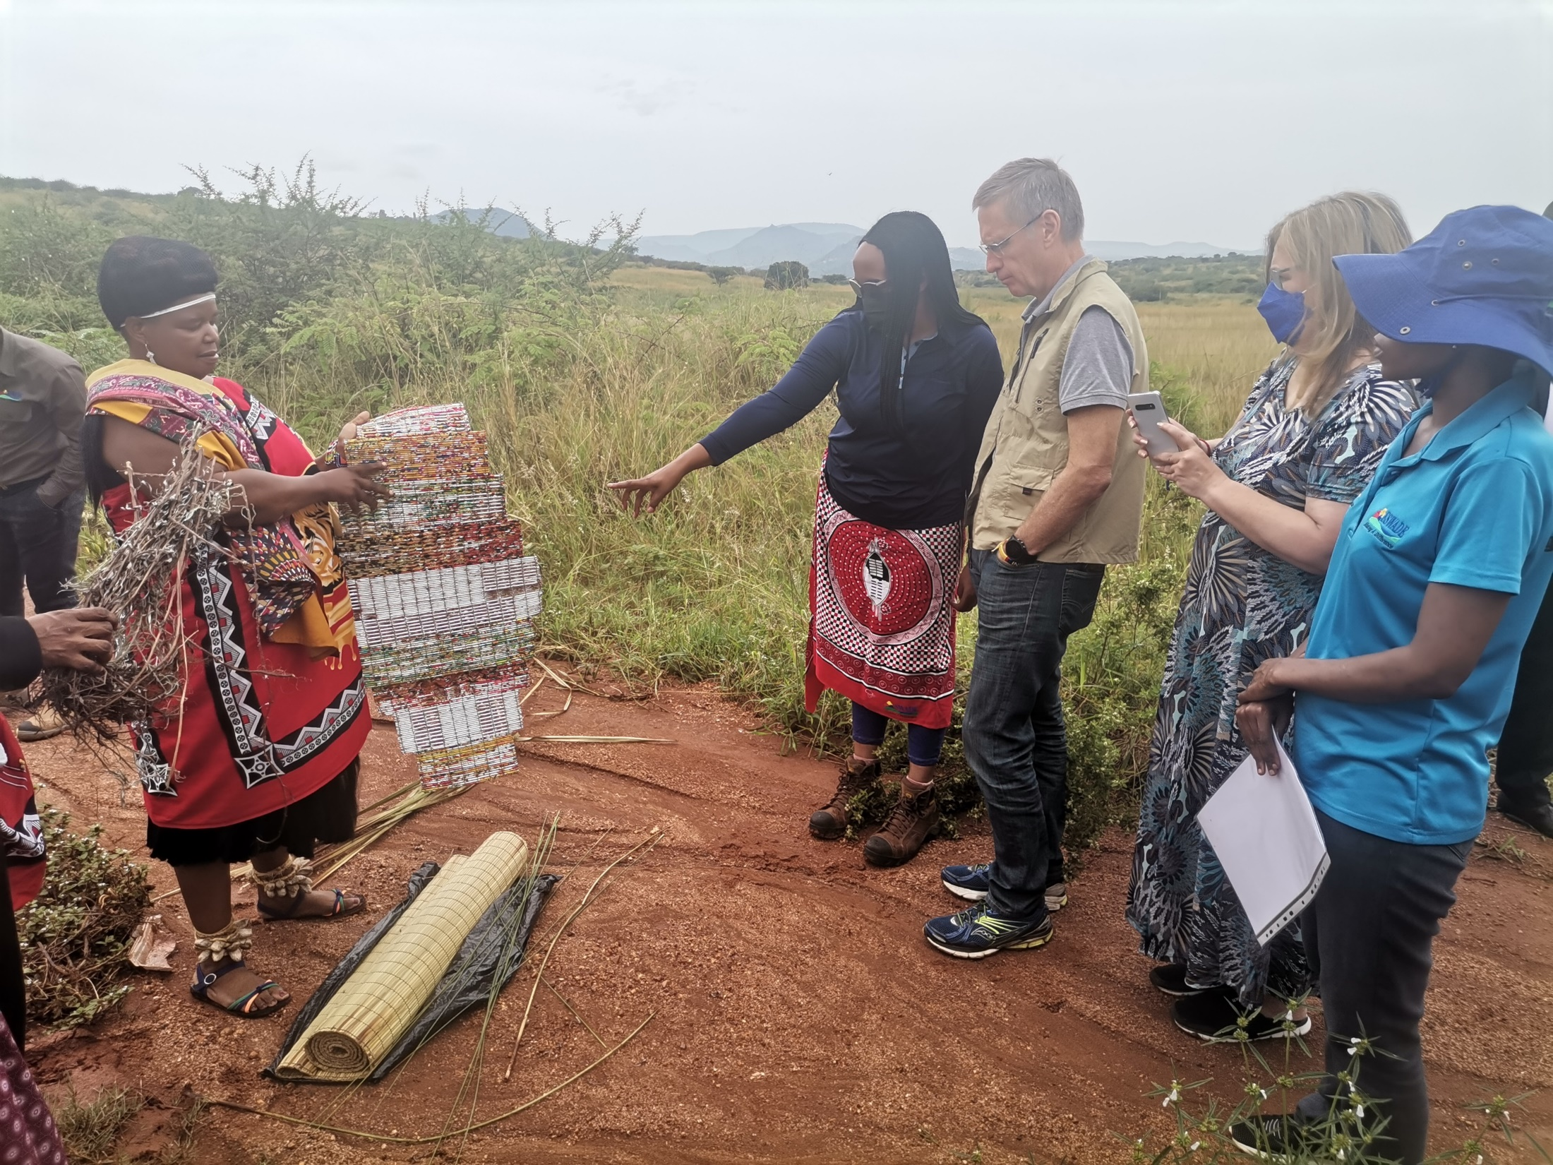
Some of the wetland resources for economic use value
.

Slide 15
Results of Wetland Rehabilitation for Downstream farming initiatives.

Slide 16
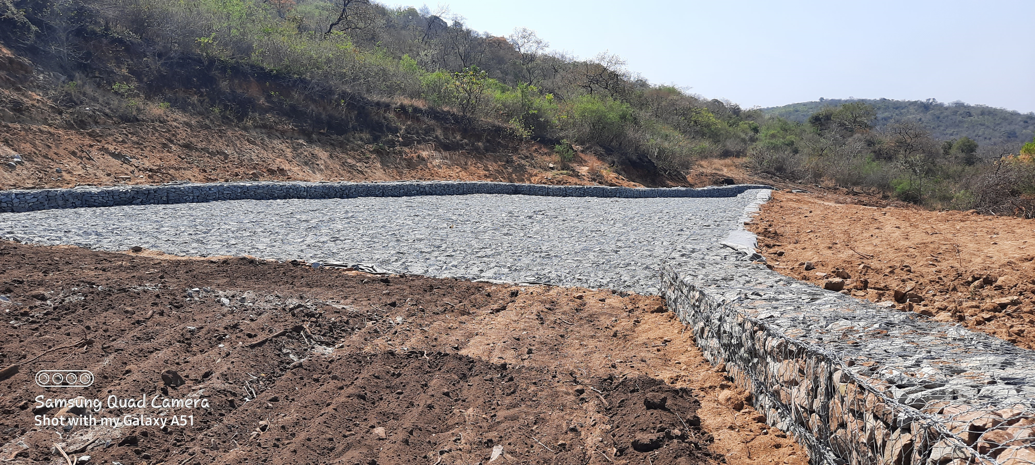
Existing Dam Spillway rehabilitation for increased downstream production

Slide 17
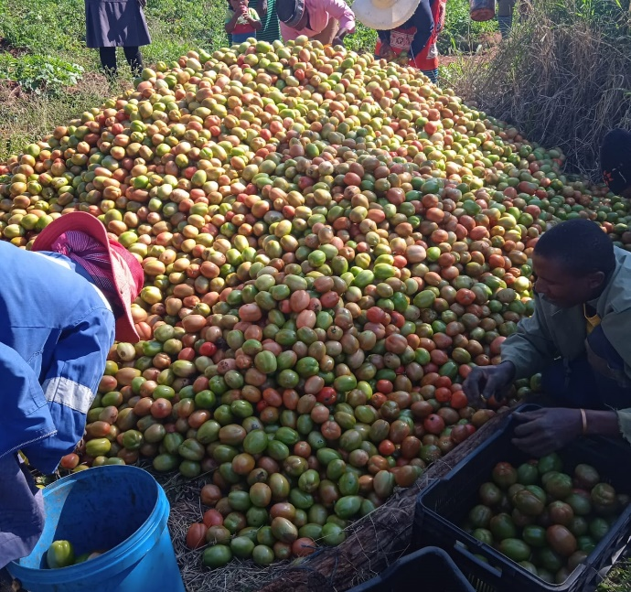
Downstream Development

Slide 18
Key lessons
Collaboration and Partnership is key at all levels.
Communities learn better from each other that from experts. Exposure visits and exchange visits among communities are therefore key.
Indigenous knowledge has to be documented. It has to be. It is so valuable.

Slide 19
Key Lessons
Traditional Authorities and Communities must be the ones realizing that they have a problem and be prepared to lead to achieve the solution.
For the sustainability of project initiatives, exit strategies must begin at the start of projects through strong partnerships with Government Ministries and Departments to allow for seamless integration into mainstream Government programmes at project end.
For sustainability, project initiatives must have economic use value for the communities.

Slide 20
THANK YOU

