Slide 1
Why Building Resilient & Sustainable Food Value Chains is the Only Viable Option for a Food Insecure Sub-Saharan Africa?

Slide 2
“Africa has the largest amount of uncultivated and yet arable land and abundantly rich water bodies, a youthful population and a massive yield gap. This combination of factors can help the continent to shift from spending 62% of its US$78billion in annual gross income on food imports.” – Dr. Ayodele Odusola

Slide 3
The Value Chain Greening Approach
UNDP - AGRA Responsibilities in the RFS
UNDP and AGRA have four main deliverables:
Develop the Value chain greening training manual (COMPLETED)
Host 3 Project Facilitation Platforms in East, Southern and West Africa (COMPLETED)
Develop 3 Knowledge Products, based on the 3 catalytic grant-supported business/greening projects (IN PROGRESS)
Develop a Value chain greening toolkit, for adaption and use by stakeholders interested in value chain greening, in the future (IN PROGRESS)
1st
Value Chain Greening Training
2nd
3rd
3
Sub-regional
Project Promoters
3 Knowledge Products
Project Facilitation Platforms
4th
Value Chain Greening Toolkit
The HUB
The RECs
12 RFS COUNTRY PROJECTS

Slide 4
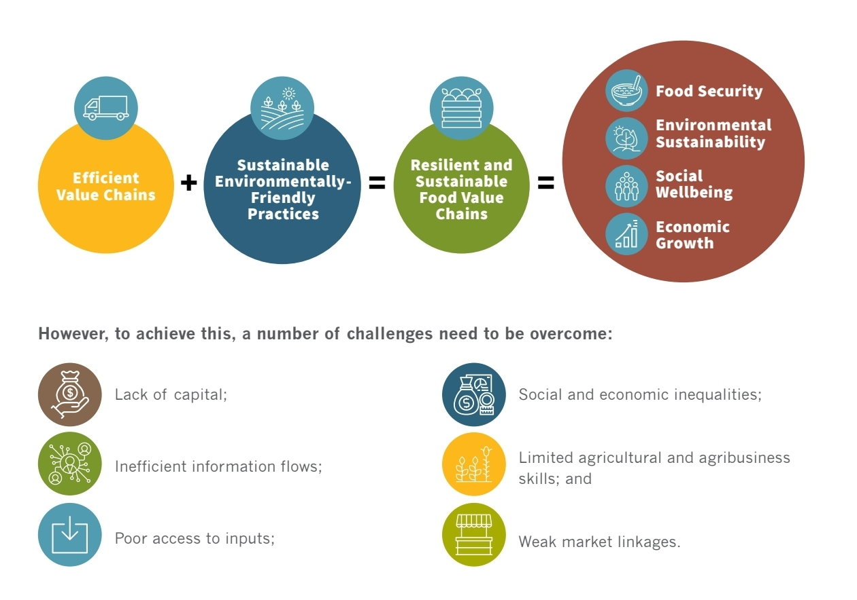

Slide 5
The Lake Zone Smart Farms (LSF) project will promote sorghum value chain in Tanzania’s Lake Zone farming region and Uganda by strengthening local market linkages and promoting regional trade.
• Strengthened/formalized farmer/locally owned sorghum aggregation centres.
• Sustainable and structured sorghum marketing agreements between local input and output markets
• Increased incomes per household due to increased productivity and marketed commodity
• At least 2,000 sorghum producers and 100 agro-preneurs have access to crop and financing
• At least 30,000 MT of sorghum aggregated and sold through national and regional structured markets.
• Improve the farmer-extensionist ratio to at least 1: 250/300, through mobilization and training of lead farmers in climate smart agriculture (CSA)
OVERALL GOAL:
to directly support the transformation of 25,000 smallholder-farming households, 40% of whom are woman-led.
The project will also impact 100 MSMEs of sorghum aggregators, input and other service providers in the Lake Zone
The Sorghum project addresses the following challenges:
• Low farmer incomes due to limited production-for-sale operations, low sales volumes and limited crop diversification.
• Low sorghum productivity due to the insufficient use of technology for crop production, rendering farmers vulnerable to climate shocks.
• Limited access to input finance. Financial institutions tend to refrain from lending to farmers unless they have a reliable market for their produce.
• Limited access to structured markets has led to farmers selling their produce at a loss early in the season as they are unsure of

Slide 6
Cereal production is projected to decline from 45million tonnes (Year 2021) to 38 million tonnes (Year 2022 year) worldwide.
#CovidPandemic
#RussiaUkraineConflict
60% of Africa’s smallholder farmers can shift from subsistence to supplying the commercial markets as well become market-oriented individual businesses by year 2040.
While we all can measure poverty and food insecurity, How much productivity potential does each smallholder farmer harbor and is able to harness in order to contribute to localized food processing activities and socio-economic growth?

Slide 7
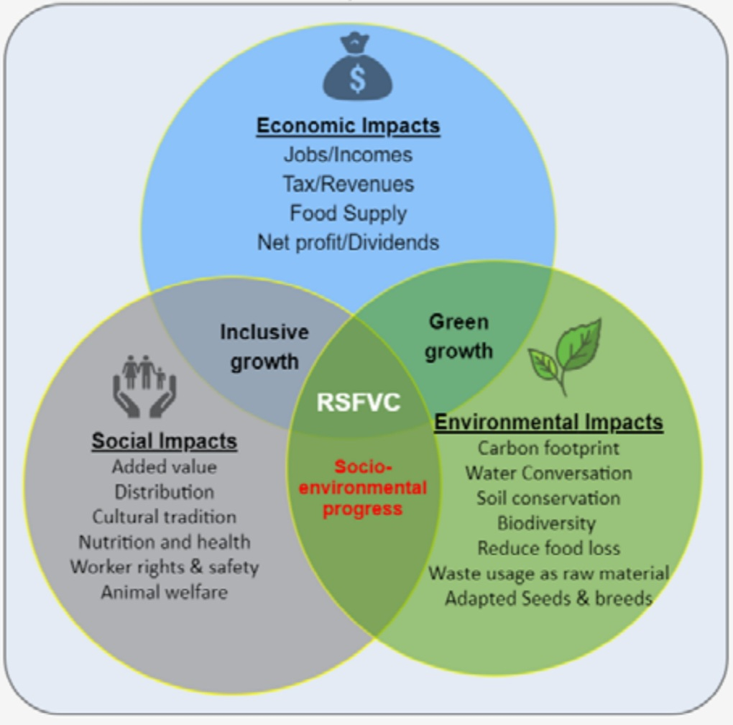
In order to achieve most of this Production and Agribusiness Growth Potential there is need for collaborations between the smallholder farmers, the private sector and BDS (Support service) providers and governments
There is need to Set up Strategic Multistakeholder platforms that aid for collective problem-solving mechanisms via business modelling
Population growth projected to grow to 9.3billion by 2050 vs Current food output needs to grow by 53%
Resilient and Sustainable Value chains Successfully established

Slide 8
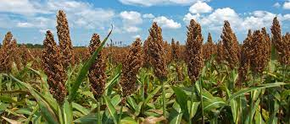
The Kilimo Trust-led Sorghum Value chain greening Project Outputs
From a base figure of 12%, 65% of 30,000Smallholder farmers now have access to mechanized threshers - Quality of Crop Improved
Shortage of Inorganic Fertilizers:
Kilimo Trust have been promoting Regenerative agricultural practices to recycle Sorghum and Rice crop waste.
- 11,000 smallholder farmers trained
Local and Export market development: 2,000 sorghum producers and 100 agro-preneurs have capacity to aggregate high quality crop and subsequently have access to financial service
Improved crop throughput: Farmers on average increased their crop output from 650kg/ha to 1050kg/ha in one season
NB: All values and statistics are based on Program Targets and observations during the Project Monitoring and grant support related random sampling exercise

Slide 9
The Role of UNDP and AGRA in the Greening of the Sorghum Value chain in Tanzania
Main Activity:
Evaluation of the Sorghum value chain and the profitability of smallholder farmers cropping model.
Most of the crop is sold to an export market, particularly in Kenya and South Sudan
Farmers are willing to increase hectrages under Sorghum, given the viability of affordable tillage and threshing service
Outputs and Gaps Identified in the Lake Zone Sorghum VC greening project
UNDP –AGRA Project Contributions
Food Value chain Greening Program benefitted 29,500 Smallholder farmers and extension staff – training and input support
PFP for greater collaboration between Key Stakeholders
Exchange visit for the Thresher fabricator to Munyegera Initiative in Uganda:
-to develop Entrepreneurial skills and copy the service costing model
Diversify the range of crop the thresher handles from one crop (sorghum only) to Maize, Sorghum and Rice
Contribute to Musoma Foods Pvt LTD’s Marketing strategy
Availability/Accessibility of the Value chain greening e-course
And limited ability to effect tangible benefits from collaborations with PCU Partners
Multi Stakeholder Platform Approach

Slide 10
Thank you!!!

