Slide 1

Knowledge Exchange and Learning Workshop
Learning Labs
Annual Programme Workshop 20th-23rd September 2022 Blantyre, Malawi

Slide 2
The Food Value Chain Framework:
Greening 4 Resilience & Sustainability
By Mcloud Kayira and Assan Ng’ombe - AGRA

Slide 3
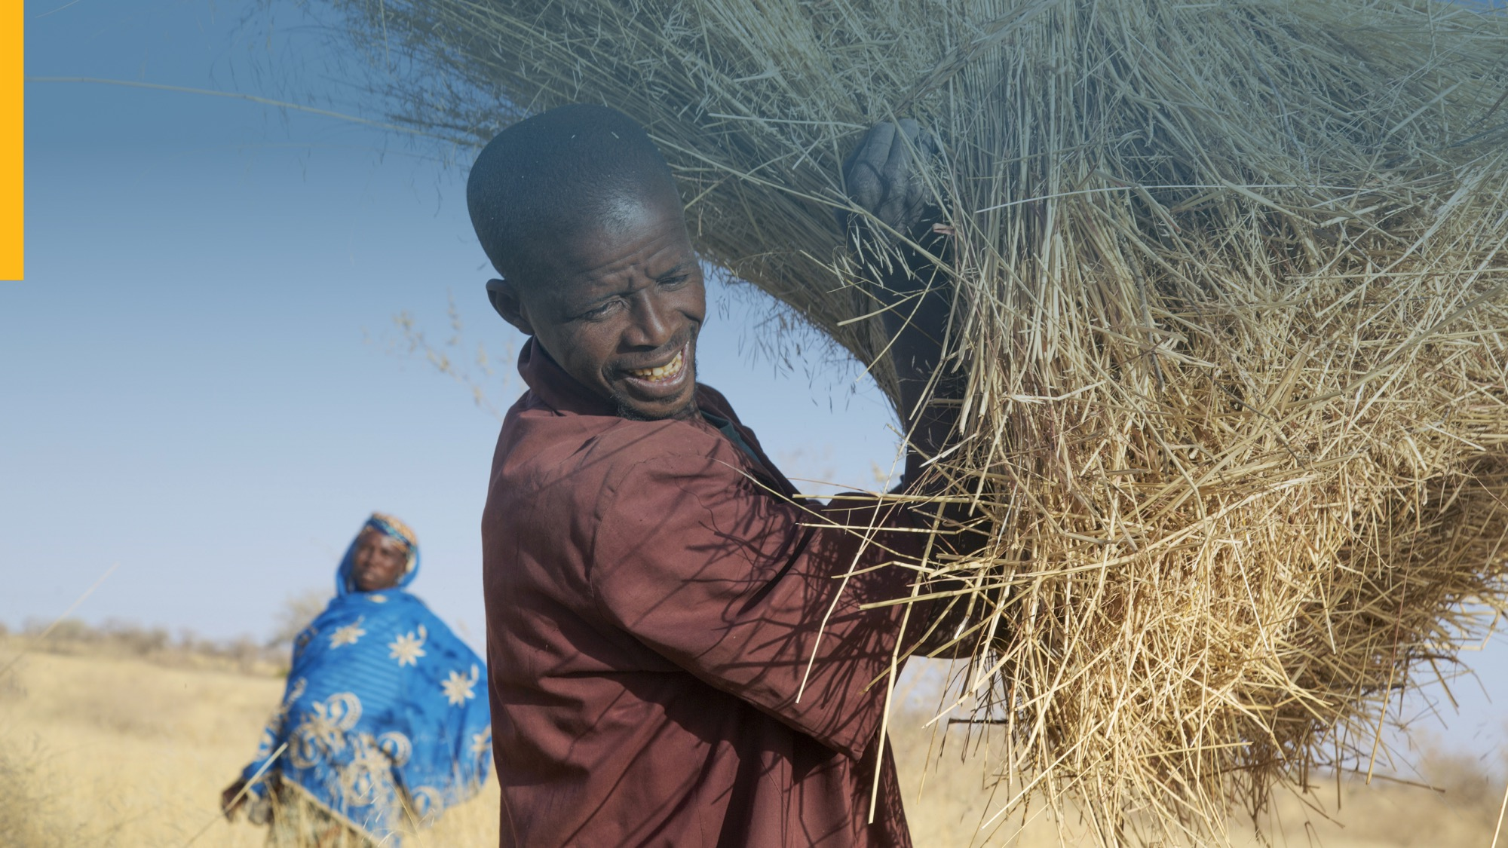
Why Value Chains are Critical for Resilience and Sustainability
Helps us understand:
Holistic Processes
Steps
Players/Stakeholders
Contextualized impacts
Points of vulnerability (to Climate, Environmental, Economic and other shocks)
Entry points for interventions and investments
They offer the smallest points of collective impacts for tipping points

Slide 4
Why Value Chains are Critical for Resilience and Sustainability
Happen at the various points of food value chains
Vulnerability and Impact:
Environmental Degradation
Climate Vulnerability
Business and Market sustainability

Slide 5
Value Chain Greening Template
Inputs
Production
Logistics
Processing
Marketing
Name of Current Value chain Actors:
Current OPERATIONAL Issues affecting actor viability across the Value chain
Poor Fertilizer Management
Poor Fertilizer Management
Poor Fertilizer Management
Poor Fertilizer Management
Poor Fertilizer Management
Current ADVERSE ENVIRONMENTAL ISSUES characterizing the Value chain
Overgrazing, soil salinity, high veld fire frequencies
Overgrazing, soil salinity, high veld fire frequencies
Overgrazing, soil salinity, high veld fire frequencies
Overgrazing, soil salinity, high veld fire frequencies
Overgrazing, soil salinity, high veld fire frequencies
Current MODEL/STRUCTURAL issues affecting the Value chain
Monocropping focusing on cash benefits. Lack of preproduction contracts with Market.
Monocropping focusing on cash benefits. Lack of preproduction contracts with Market.
Monocropping focusing on cash benefits. Lack of preproduction contracts with Market.
Monocropping focusing on cash benefits. Lack of preproduction contracts with Market.
Monocropping focusing on cash benefits. Lack of preproduction contracts with Market.
PROPOSED VALUE ACTORS
PROPOSED VALUE ACTORS
PROPOSED VALUE ACTORS
PROPOSED VALUE ACTORS
PROPOSED VALUE ACTORS
Proposed action plans for RSFVCD
GOOD AGRIC PRACTICES
GOOD AGRIC PRACTICES
GOOD AGRIC PRACTICES
GOOD AGRIC PRACTICES
GOOD AGRIC PRACTICES
RESILIENCE BUILDING PRACTICES & TECHNOLOGIES
RESILIENCE BUILDING PRACTICES & TECHNOLOGIES
RESILIENCE BUILDING PRACTICES & TECHNOLOGIES
RESILIENCE BUILDING PRACTICES & TECHNOLOGIES
RESILIENCE BUILDING PRACTICES & TECHNOLOGIES
STRUCTURAL/MODEL CHANGES
STRUCTURAL/MODEL CHANGES
STRUCTURAL/MODEL CHANGES
STRUCTURAL/MODEL CHANGES
STRUCTURAL/MODEL CHANGES

Slide 6
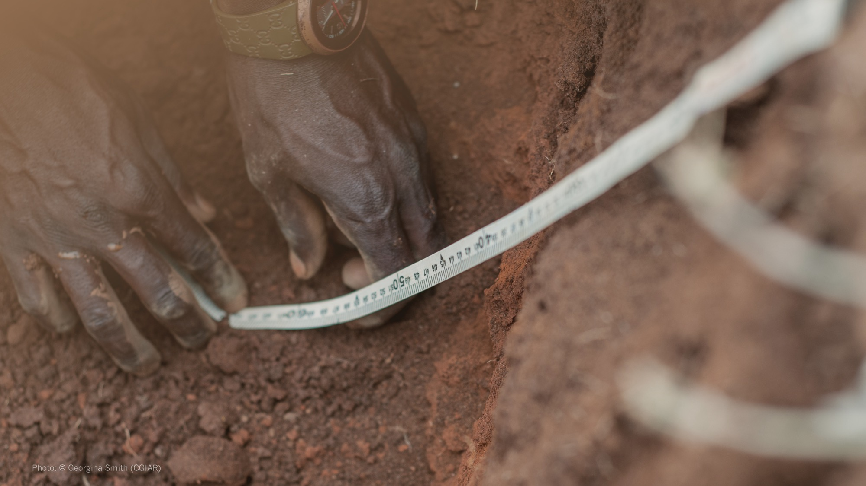
Integrating Value Chain Approach
(IFAD, 2014) “Value chain (agriculture): a vertical alliance of enterprises collaborating in varying degrees along the range of activities required to bring a product
from the initial input supply stage, through the various phases of production, to its final market destination”
In other words, an agricultural value chain refers to the whole range of goods and services necessary for an agricultural product to move from the farm to the final customer.

Slide 7
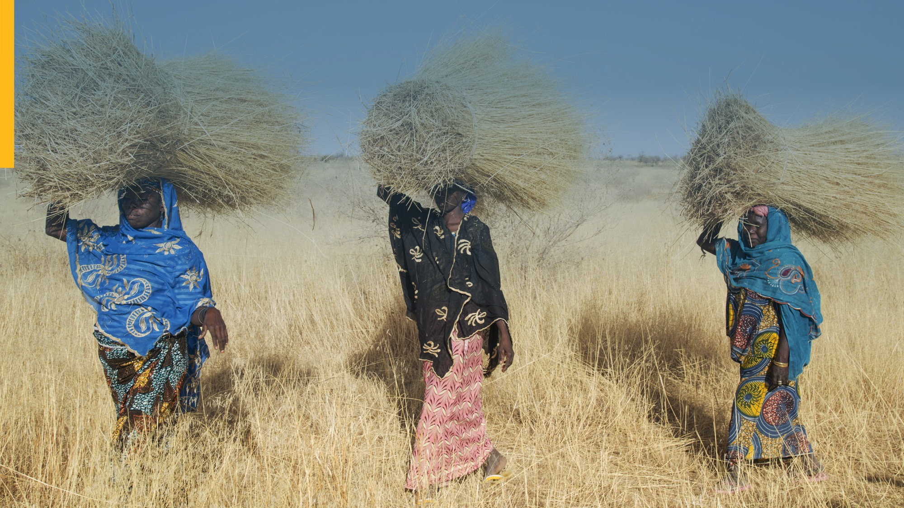
What we did
Through this framework
Provided analytical processes of Greening and Sustainability entry points for IAP projects in Uganda, Malawi, Nigeria & Tanzania
Developed a training and analytical capacity building tool (Value Chain Greening Manual)
Developed Proof Point or Catalytic Grant Projects
  Building Sustainability and Resilience through the groundnut Value Chain in Malawi
  Promotion agriculture diversity for increased income, nutrition and farm level biodiversity through the Sorghum Value Chain in Tanzania
  Building resilience and Sustainability in the Maize value Chain by promoting resilient seed and market sustainability in Burkina Faso

Slide 8
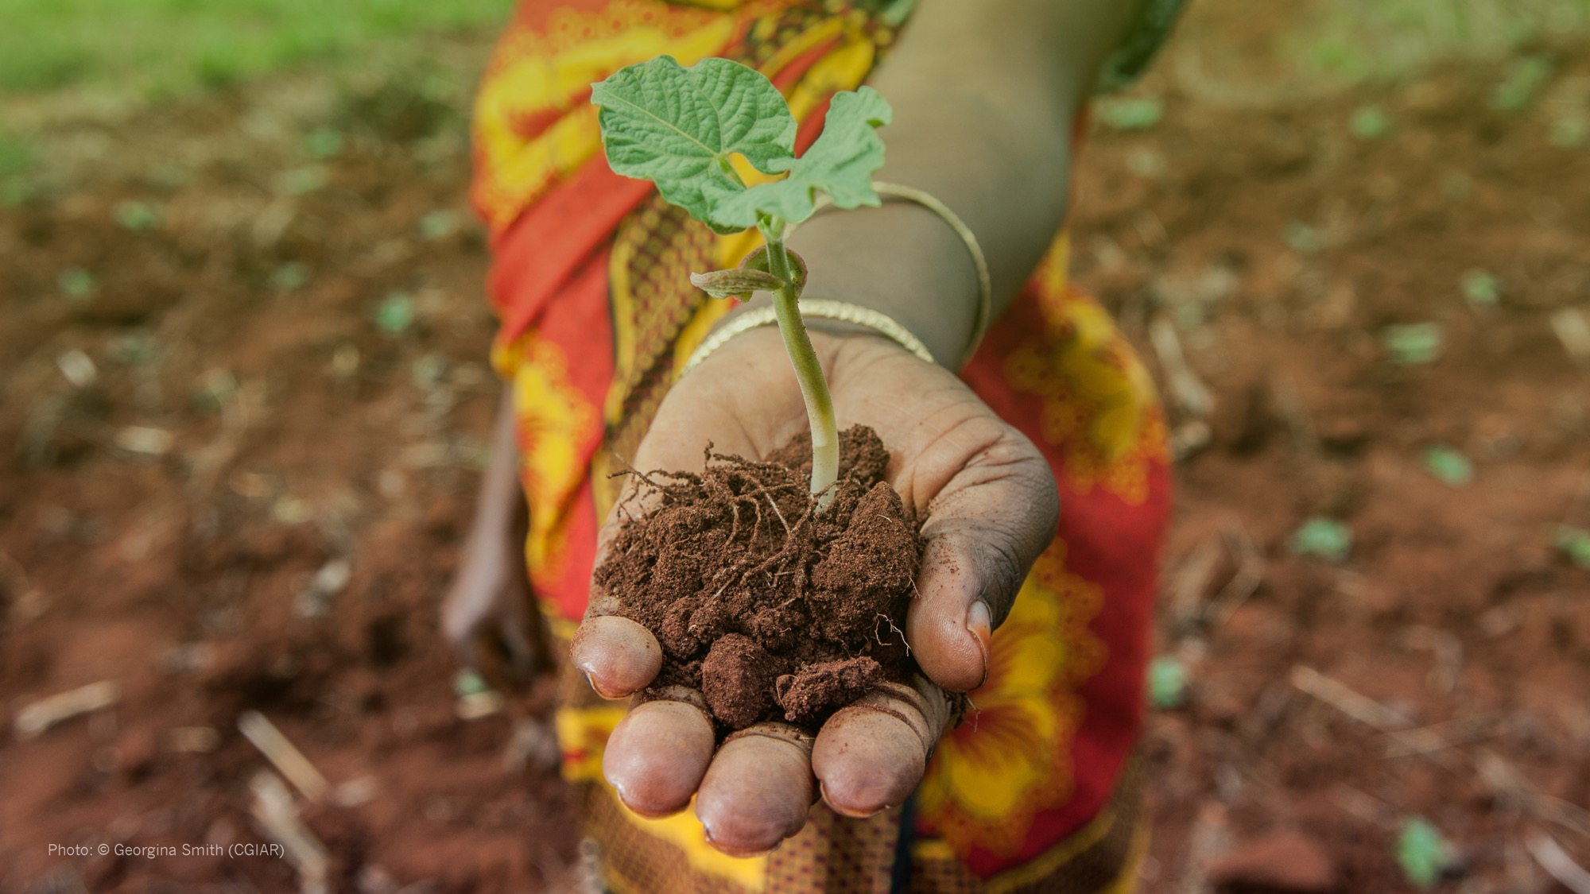
Learnings from what we found and early results
The concept of [green] food value chain development was not widely understood nor used in the IAP project (Food-IAP) across all the countries we worked with
The concept and use of Multi Stakeholder Platforms was identified an effective entry point for building private sector/market and environmental sustainability in Food Value Chains
Other factors such as having an effective extension system, guaranteed markets, use of science, partnerships are key in value chain development

Slide 9
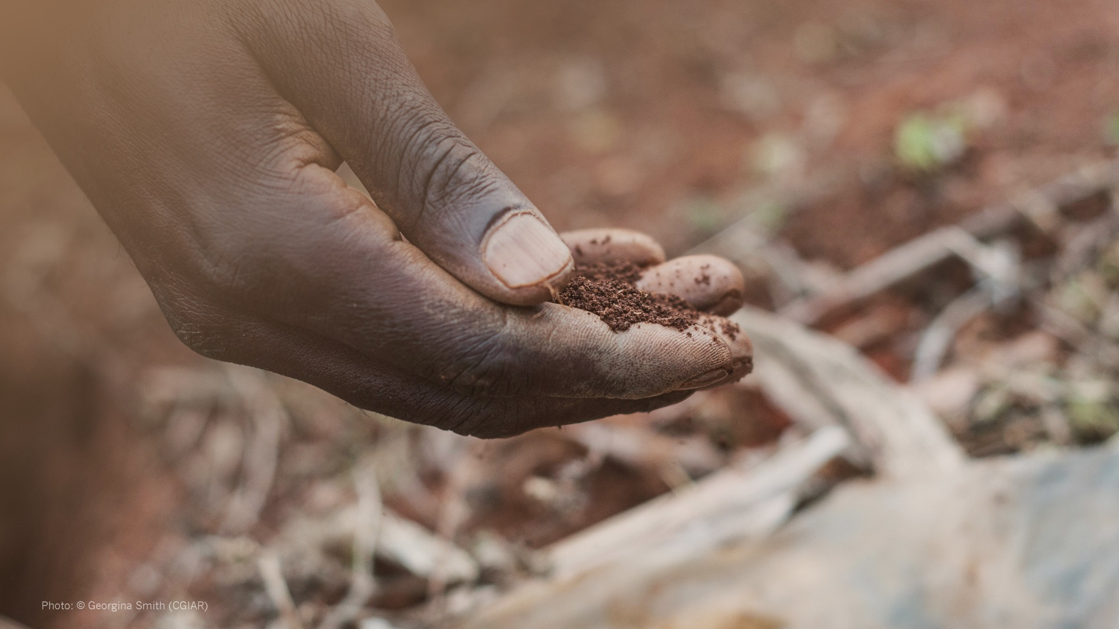
Going forward
Building consistency and scale
Policy and institutional support for an enabling environment
Building more evidence on markets
Building more partnerships among technical agencies and private sector
  AGRA worked with FAO in Uganda
  On the ground, AGRA is working Off-takers such as Musoma Food, Pyrux on food safety, food processing, innovative extension systems

Slide 10

Going Forward Cont’ed
Project design
  the design and implementation of IAP projects were not aligned with the Hub projects making it difficult to provide technical support to the countries
Time for impact
  Resilience and sustainability project require time to mature
  Knowledge intensive, learning and adaptive

Slide 11

Partners
It is time to green value chains..
Malawi
AFAP, Fortune Gardens, AISL, Milele
Tanzania
Kilimo Trust, Musoma Foods, Government and SMEs
Burkina Faso
INERA (Ag Research Organisation), Input Suppliers, SMEs and Traders
Zikomo!
Ansante!
Merci!
Thank You!

